Slide 1
Equity <> KOKO Networks
Further detail on KOKO Tech

Slide 2
Context
On Tuesday 7th April we had an initial discussion on integration options for a new potential customer journey that would allow Equity customers to buy KOKO products using Ecomoto loans (see right). Further information was required from both sides to understand more about the options available.
Regarding customer acquisition (sign ups and orders); KOKO already has multiple technology options available but are keen to understand if Equity have other tools they would like us to consider, which their agents currently use?
With regards to payment receipts, we currently integrate with Safaricom’s APIs to receive mobile money from individual customers. However we are open to other options available (with a preference for API integration) that Equity can offer for receiving payments.
This document outlines a bit more detail on KOKO Tech - please do let us know if you have clarifying questions.
Proposed Customer Journey
Customer walks into an Equity Bank agent shop
Equity Agent signs up customer
Customer applies for Ecomoto loan for KOKO Cooker (either via USSD or Equity Bank app) and selects the amount they want to borrow
Customer is approved for Ecomoto loan within 3-5 minutes
Equity Bank sends funds to KOKO
Customer account is credited in KOKO Wallet
Customer receives confirmation of paid order and can now collect their cooker
Agent sees customer payment in myKOKO
Agent helps customer find their nearest KP to collect cooker

Slide 3

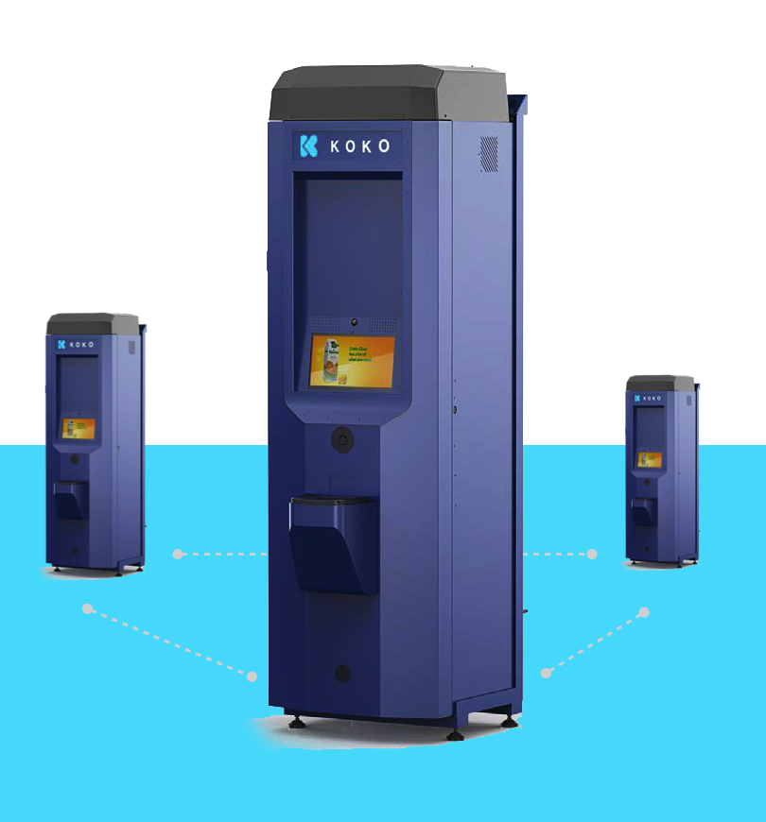
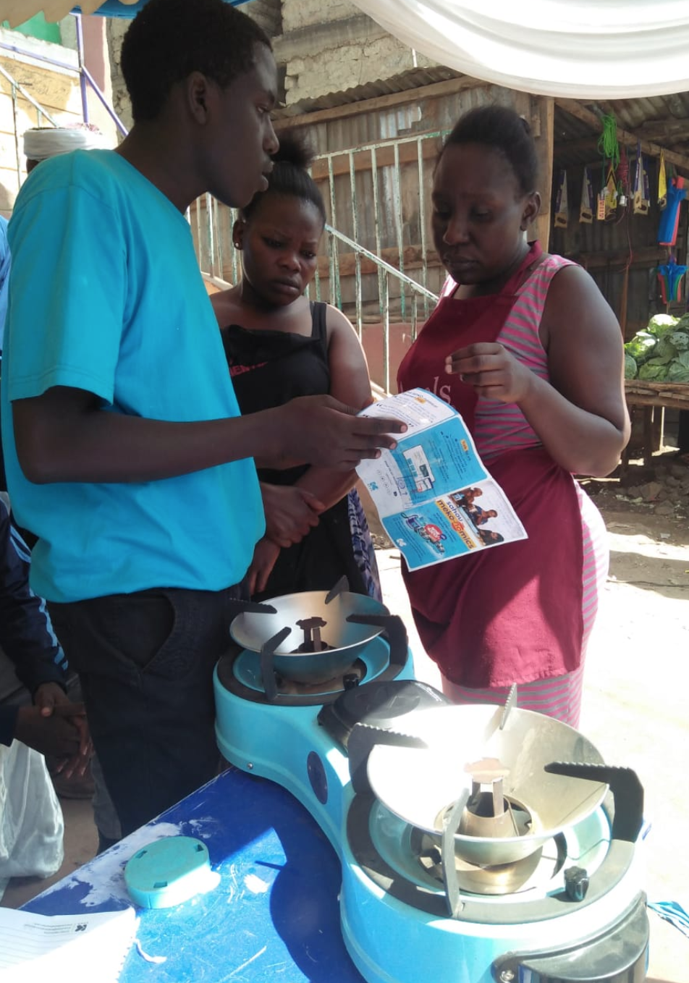
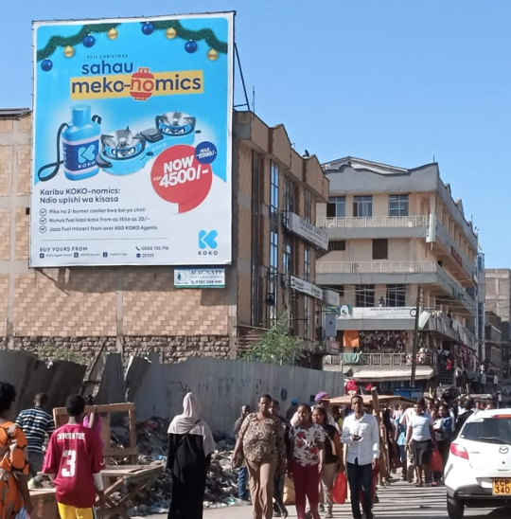
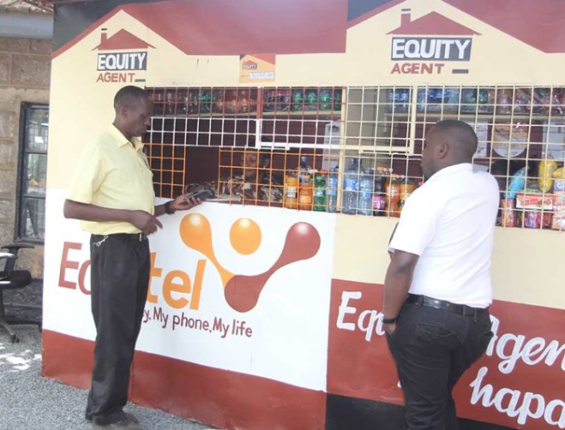
Customer Acquisition Channels
KOKO Agents who host KOKOPoints in their shops, which are used for refueling, and stock KOKO Cooker Kits. We have 650 agent locations cross Nairobi | KOKO Sales Team who work across our active neighborhoods in Nairobi signing up customers, running demos and sales pitches, and helping customers to find their nearest KP | Physical and digital marketing, not limited to billboards, radio and tv, Facebook, Instagram | And potentially Equity Agents who could also help upsell the KOKO Cooker Kit

Slide 4
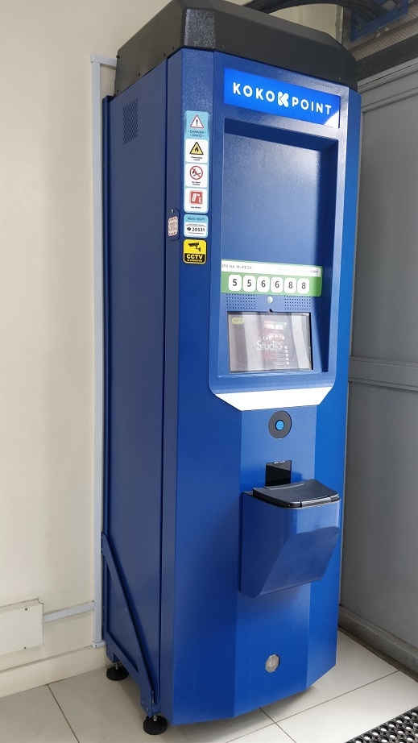
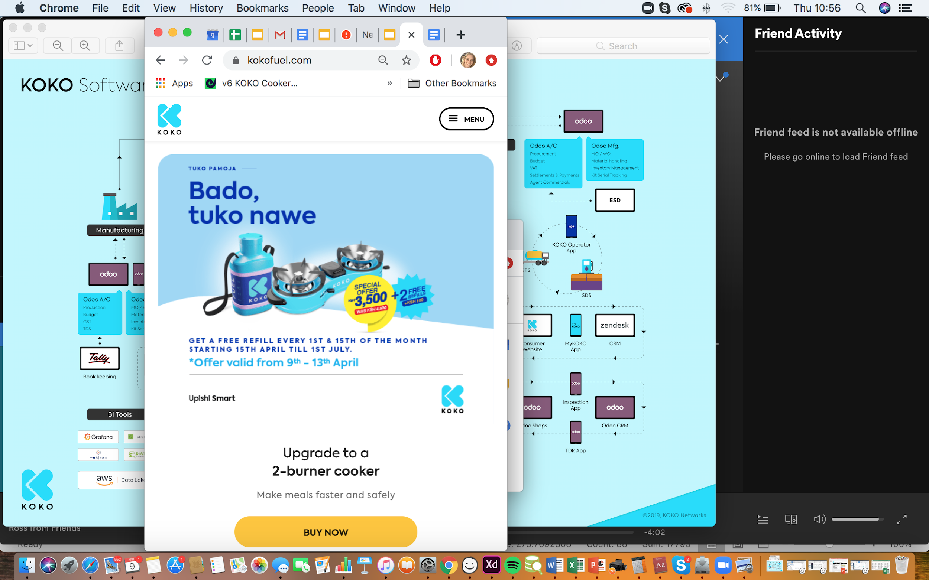
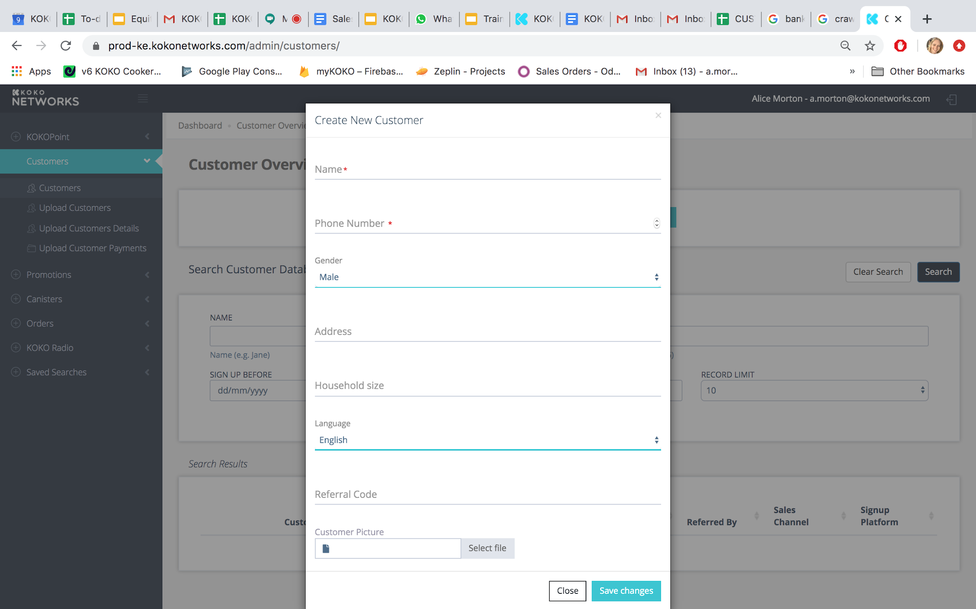
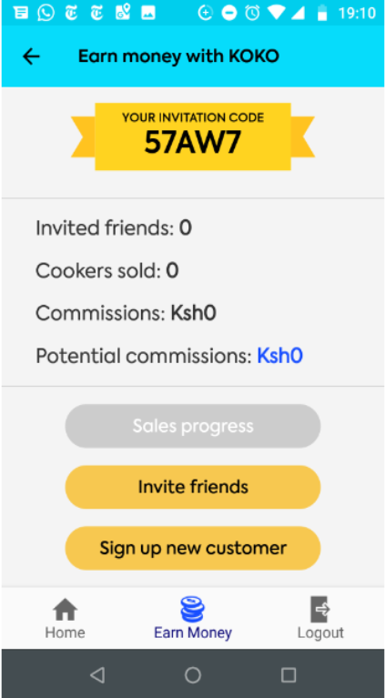
Tools for Customer Acquisition
myKOKO app
KOKOpoint
KOKO website
KOKO Core
The myKOKO sales app which is used by Agents and Sales Reps to sign up new customers and encourage them to save towards their new cooker. Users can see the progress of each customer they have signed up | Customers can place orders for both KOKO Cooker Kits and extra canisters on the KP. When collecting cookers they are given free fuel and also watch educational content about how to use their new cooker. | Customers can also create an account and order on our website kokofuel.co.ke. The site can also be used for finding where our KOKOPoints are located. | We also have some manual options available for creating customers in our back end system if for some reason the customer cannot sign up through any of these other options

Slide 5
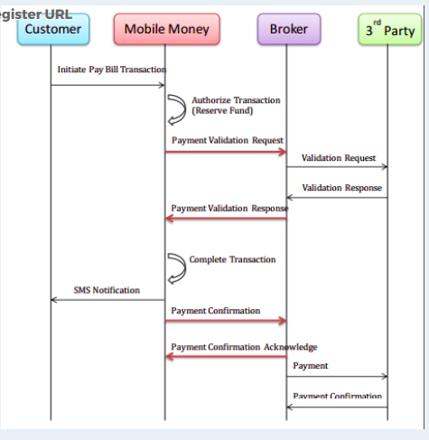
How customers pay KOKO
Customers use a Buy Goods & Services Till (556688) to add money to their KOKO Wallet. Money in their KOKO Wallet can be used to buy a KOKO Cooker or KOKO Fuel, or transferred to another user’s account. The high level steps are summarised below, with further technical detail below that.
Customer sends money via Buy Goods
We receive a notification from Safaricom
In the Safaricom request we receive the customer’s phone number
If that number exists in our database we use that to top up the customer’s wallet.
If that number does not exist in our database, we create an account for them automatically and store the money against that account.
We have integrated with Safaricom’s C2B API (see sequence diagram below), where if a customer tops up via mobile money, Safaricom sends a validation request and payment confirmation to KOKO (the 3rd party in this diagram).

Slide 6
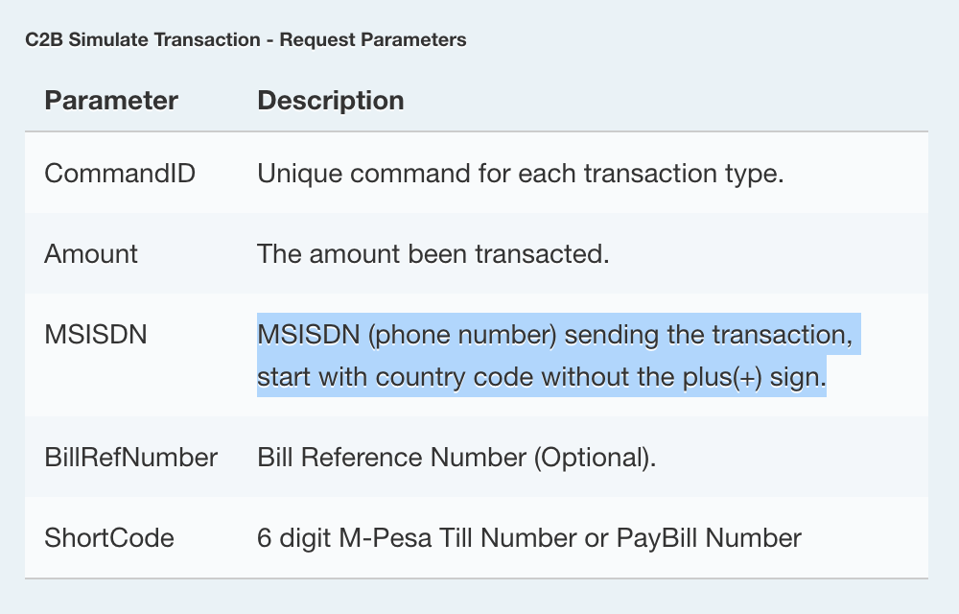
How customers pay KOKO (2)
Customer will trigger a payment request though MY KOKO app (STK PUSH) or pay using payment details provided (Buy Goods - 556688) therein and pay directly through SIM toolkit Mpesa Menu.*
Mobile Money (Safaricom) sends a validation request from the broker which tells us the phone number of the individual sending money to the till (see image right)
We respond to the broker with a validation response allowing the payment to come through.
The broker sends a payment validation request to Mobile Money so Mobile Money can proceed to complete the transaction.
Mobile Money completes the transaction and the customer gets notified via SMS.
Mobile Money sends payment confirmation to broker and broker acknowledges before it triggers a payment confirmation request
Broker sends a payment confirmation request to our Registered callback URL that transaction was completed.
At this point we attribute the money to the individual’s KOKO wallet, based on the number in the validation request in step 2.

Slide 7
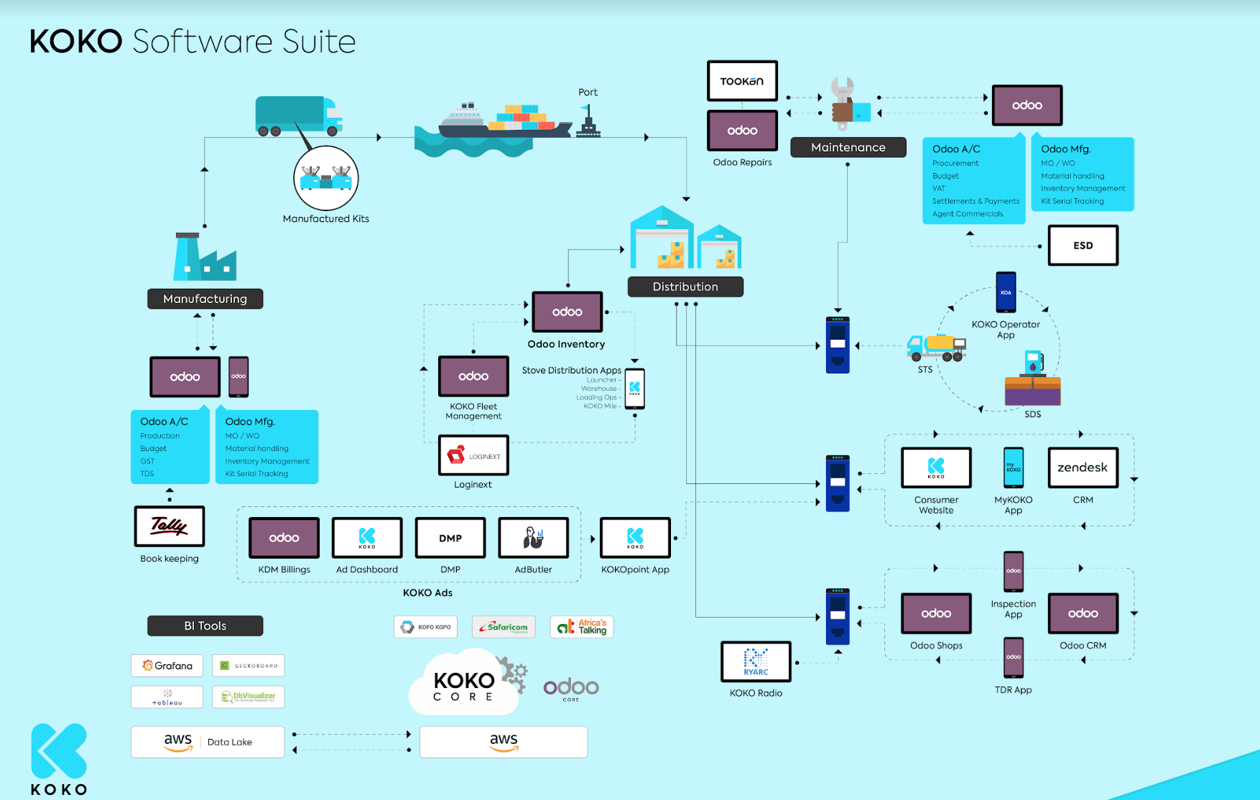
KOKO software suite

Slide 8
Potential Integration

Slide 9
High level customer journey
Equity customer decides to buy a KOKO Cooker
Customer is signed up on myKOKO by Equity Agent
Customer opens Equity USSD
Customer navigates through the ecomoto steps
Loan granted to customer by Equity
Proposed Technical Integration in Slide 10
Funds sent to KOKO’s Equity account
Funds distributed to customer’s KOKO account
Order is paid -
customer can collect Cooker

Slide 10
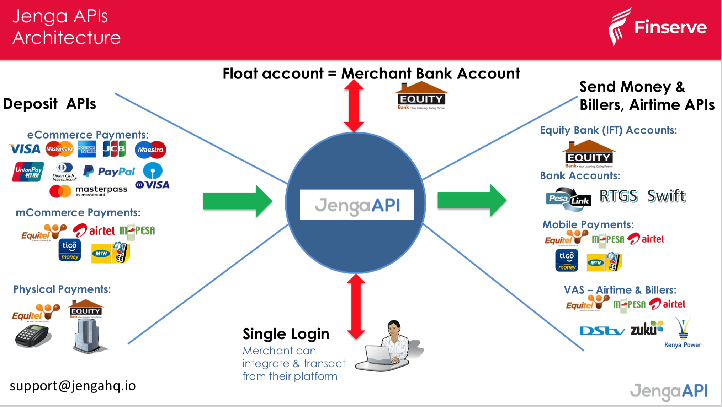
Is the Account Alerts callback notification the best way to inform KOKO systems about an Equity Customer loan disbursement?
reference:
https://developer.jengaapi.io/docs/callbacks
If so, can you provide an example of an eco moto loan disbursement notification (all alert callback API fields populated with the data we would receive)
Will we receive loan disbursement as a deposit in our Merchant Bank Account ?
Is Eazzy Pay the m-commerce solution for loan disbursements and customer payments?

Slide 11
Integration Proposal
Looking at the documentation we think it is possible to leverage the Jenga API to receive funds and distribute to individual accounts (see diagram on previous page). Is this integration feasible?
Commercial Questions:
How is money sent to our Equity Bank account for a loan disbursement - Eazzy Pay?
If we have an Eazzy Pay Till is it already mapped to the same merchant account so that customer payments can also come through the same channel?
Is it free for a customer to send money to an Eazzy Pay till? Is it free for KOKO to receive the customer’s money or are there charges?
Technical Questions
Please confirm which API is used to notify us of incoming loan disbursements for customers (see previous slide)?
Please confirm information would be passed in the API body for a loan disbursement?
What are the prerequisites to get started with this solution? Assuming an equitel mobile money account? Any technical / security requirements? Looking at the Jenga documentation, it appears to be fairly simple to set up a Jenga HQ account but is there anything else we should be aware of?

Slide 12
Alice Morton | a.morton@kokonetworks.com

